Slide 1



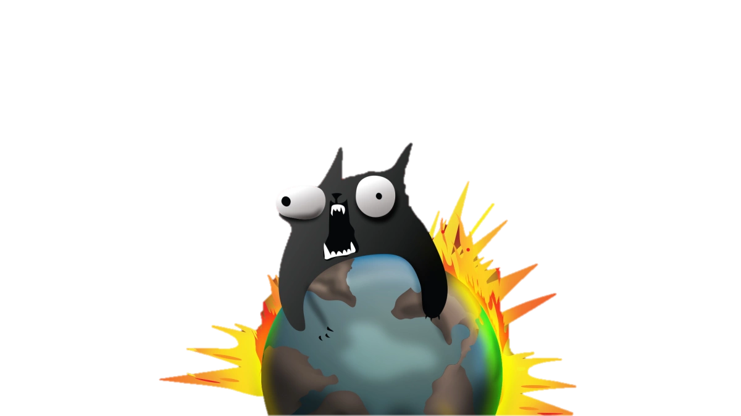

Slide 2
Whats the Game about?
It‘s all about winning! Always!!

Slide 3

Seriously
Whoever explodes loses
Who does not explode, wins
All other cards reduce the HIGHLY LIKELY to explode by exploding kittens.
Explosion by pulling an exploding kitten
Survival by luck and defuse card
Cards to :
look into the future
suspend a turn
attack fellow players
draw from the bottom
steal cards from a teammate
to reshuffle
...

Slide 4
Git and Github
Create a git project
Publish your code on Github
Connect all team members to it
Clone it to other members
Push and Pull from all members

Slide 5
Write Tests
Take the Classes from your domain model
Start developing them in Scala
Use Behaviour Driven Development
Use ScalaTest
Write a Spec using WordSpec
Use the IDEA ScalaTest Runner
Achieve 100% code coverage. And maintain it!

Slide 6
Text User Interface
Link einfügen weil zu groß und echt nicht spannend?

Slide 7
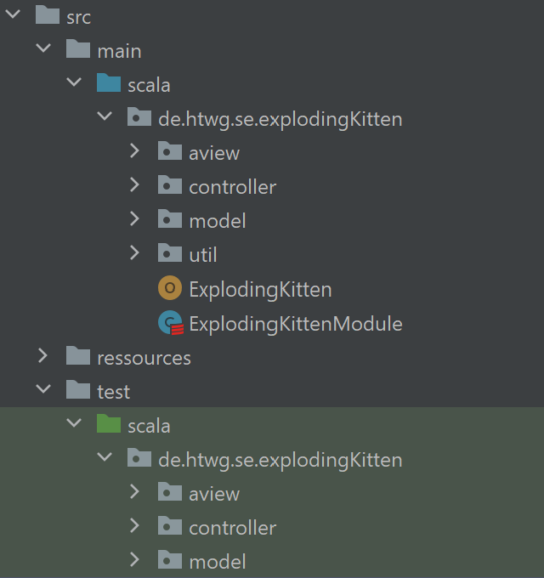
Build a MVC Architecture

Slide 8
Set up a Continuous Development Process
Make your development independant of the local platform using a build mechanism like sbt
Initiate a Continuous Integration Server on Travis or github
Set up tests and code coverage using Coveralls
Integrate Badges into your git repository
Ist momentan failing!!!

Slide 9
Design Pattern

Slide 10
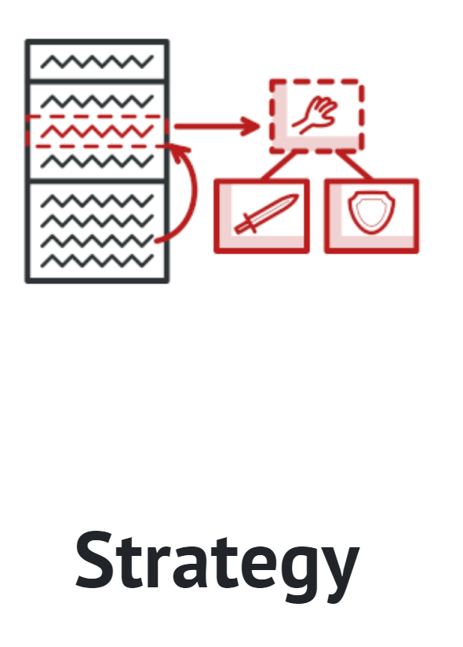
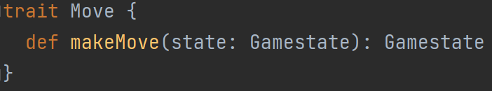
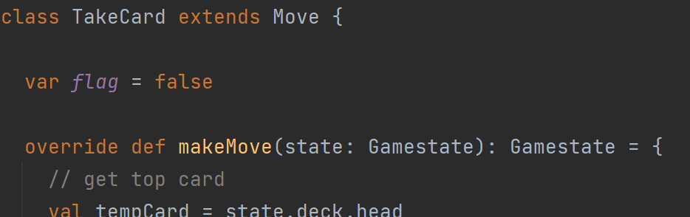
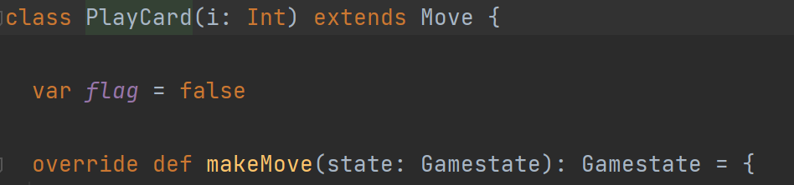
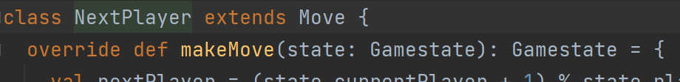
Strategy – Java Style
Context
<<interface>>
Strategy
+execute()
ConcreteStrategyA
ConcreteStrategyB
+execute()
+execute()

Slide 11

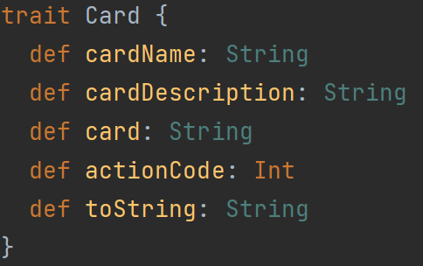
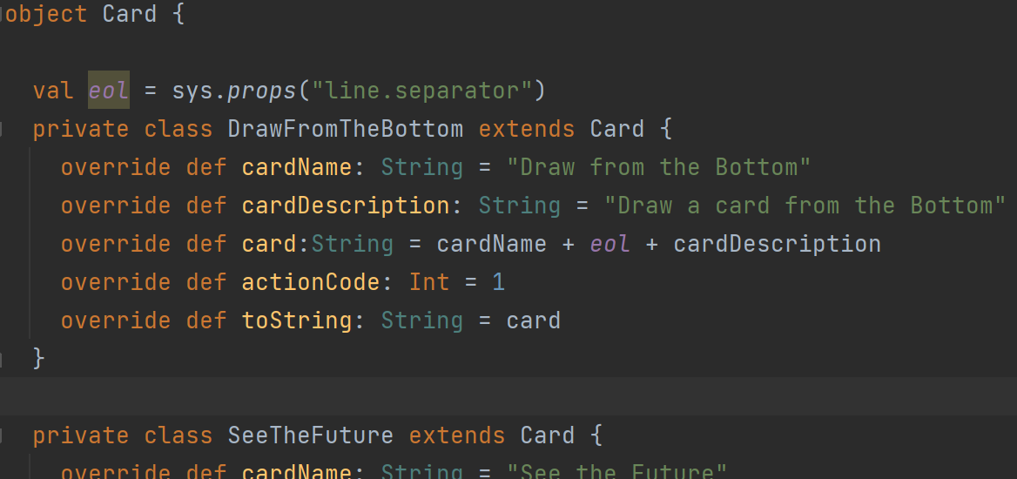
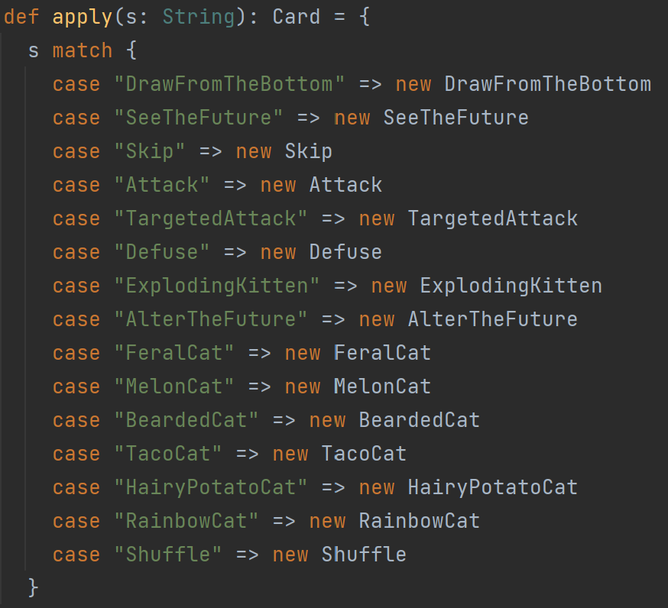
Factory
<<interface>>
Product
Creato
+factoryMethod()
+anOperation()
ConcreteCreator
ConcreteProduct
+factoryMethod()

Slide 12
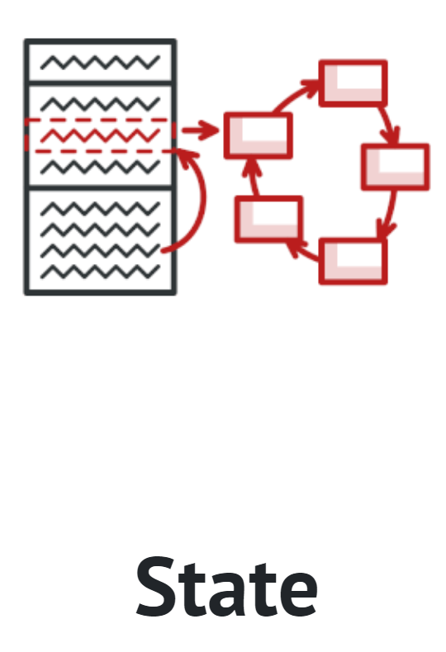
State
Context
<<interface>>
State
+request()
+handle()
ConcreteStateA
ConcreteStateB
+handle()
+handle()

Slide 13
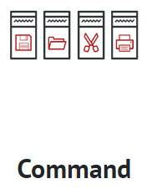
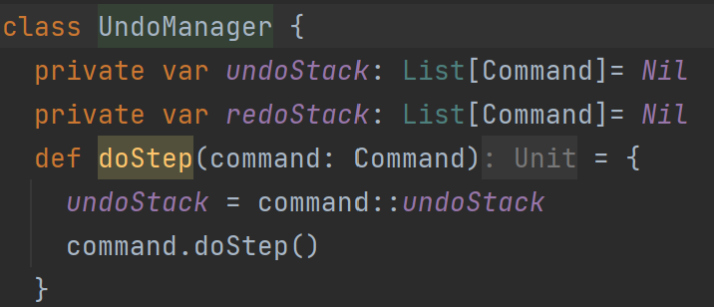
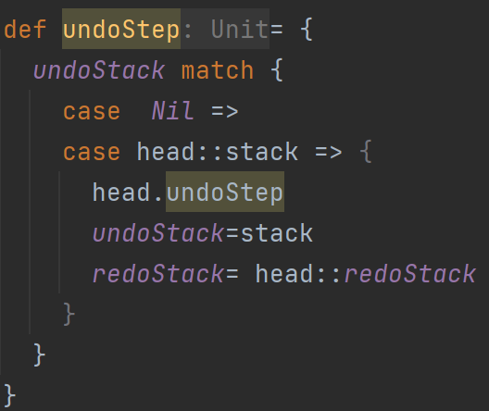
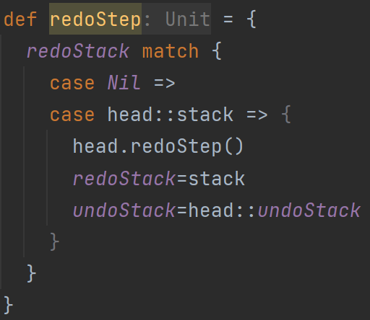
Undo
Client
Invoker
Command
+execute()
Receiver
ConcreteCommand
+execute()

Slide 14
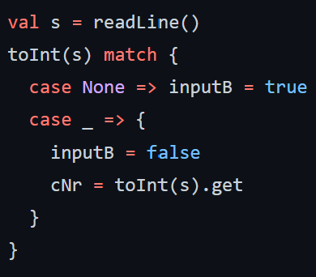
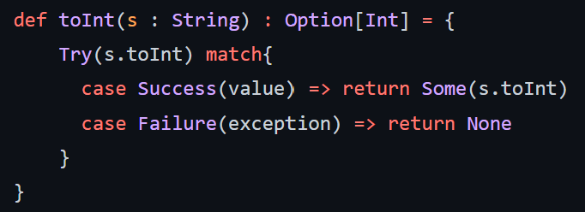
Try and Option
For testing if the imput is an Integer
toInt()

Slide 15
GUI

Slide 16
Components

Slide 17
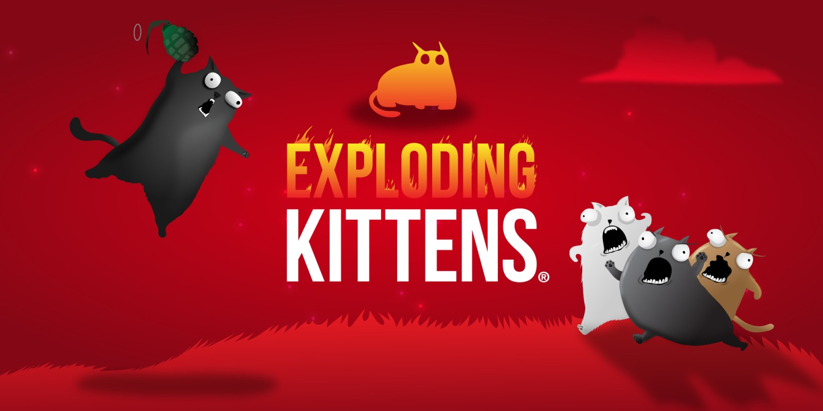
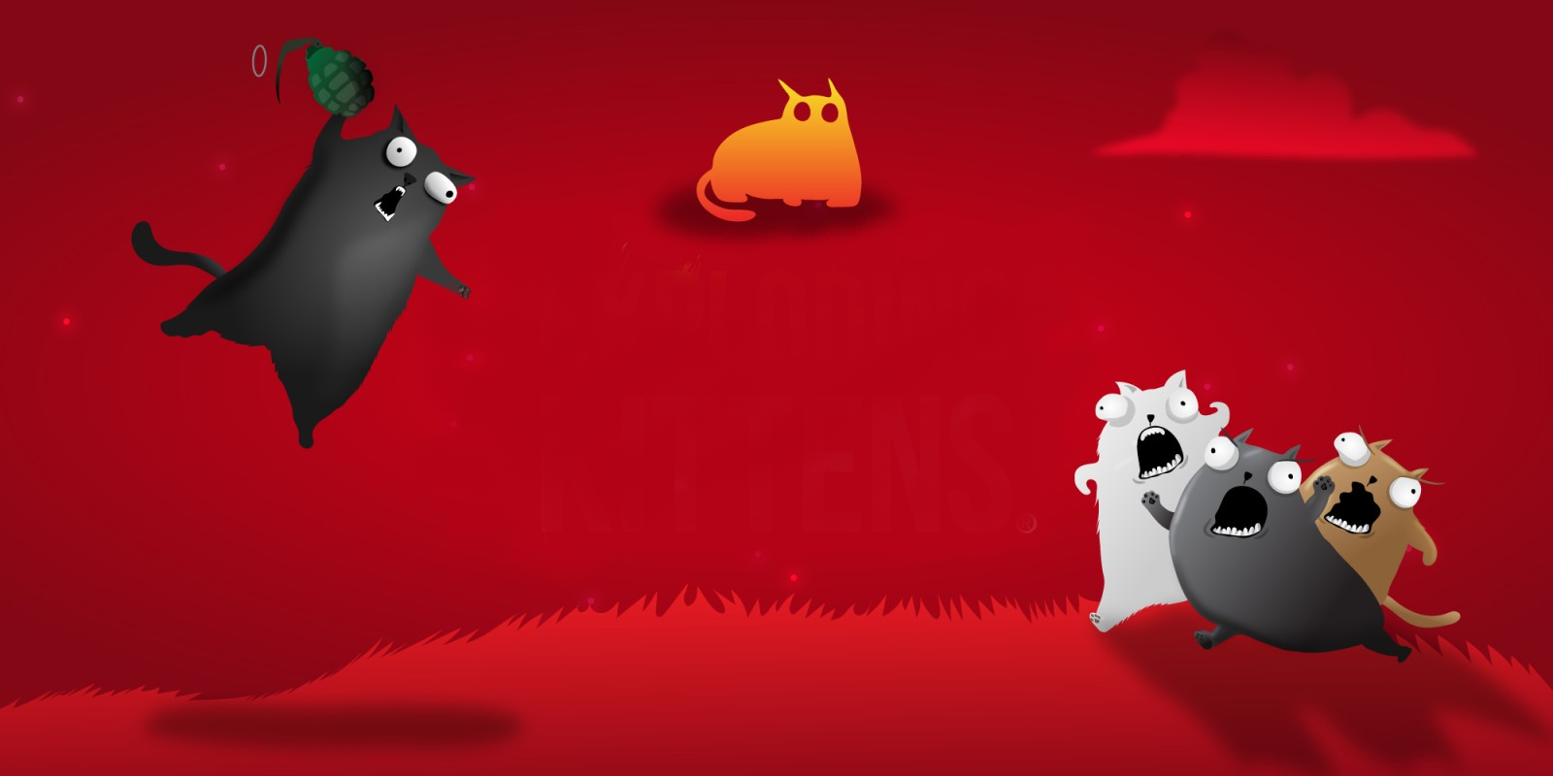
Thank you for your attention

